Slide 1

BLoOD DONATION CAMP MANAGEMENT
DBMS MINIPROJECT​
GUIDE:-
Dr A. Pande Sir

Slide 2
GROUP MEMBERS :-
RUSHIKESH M. MANJE(09)
SANGRAM R. LAD(03)
AARTI A. GUPTA(06)
ARJUN M. MANE(08)

Slide 3
PROBLEM DEFINATION
Construct an E-R diagram for blood donation system that has set of patients that can receive the blood. And also donor who donates blood. Each donor donates the blood to only one patient while each patient can accept the blood through many donors. Donor has blood bank to store the blood. Each patient can receive the blood through many blood bank and also many blood bank can provide blood to many patients.

Slide 4
Step 1 :
PATIENT is a STRONG entity set.
DONOR is a STRONG entity set.
BLOOD BANK is a STRONG entity set.
STEP 2 : (identifying Attribute)
PATIENT = { Pid , Pname , Pblood _group , Page ,
Pweight , Pdisease , Pmno }
DONOR = { Did , Dname , Dblood_group , Dage ,
Dweight , Ddisease , Dmno }
BLOOD_BANK = { Breg_no , Bname , Badd ,
Bmno }

Slide 5
STEP 3 :
1) Patient ---------- Donate----------- Donor (One to Many)
2) Donor ---------- Has -----------Blood Bank ( Many to Many )
3) Blood Bank ---------- Provide Blood ---------- Patient ( Many to Many )

Slide 6
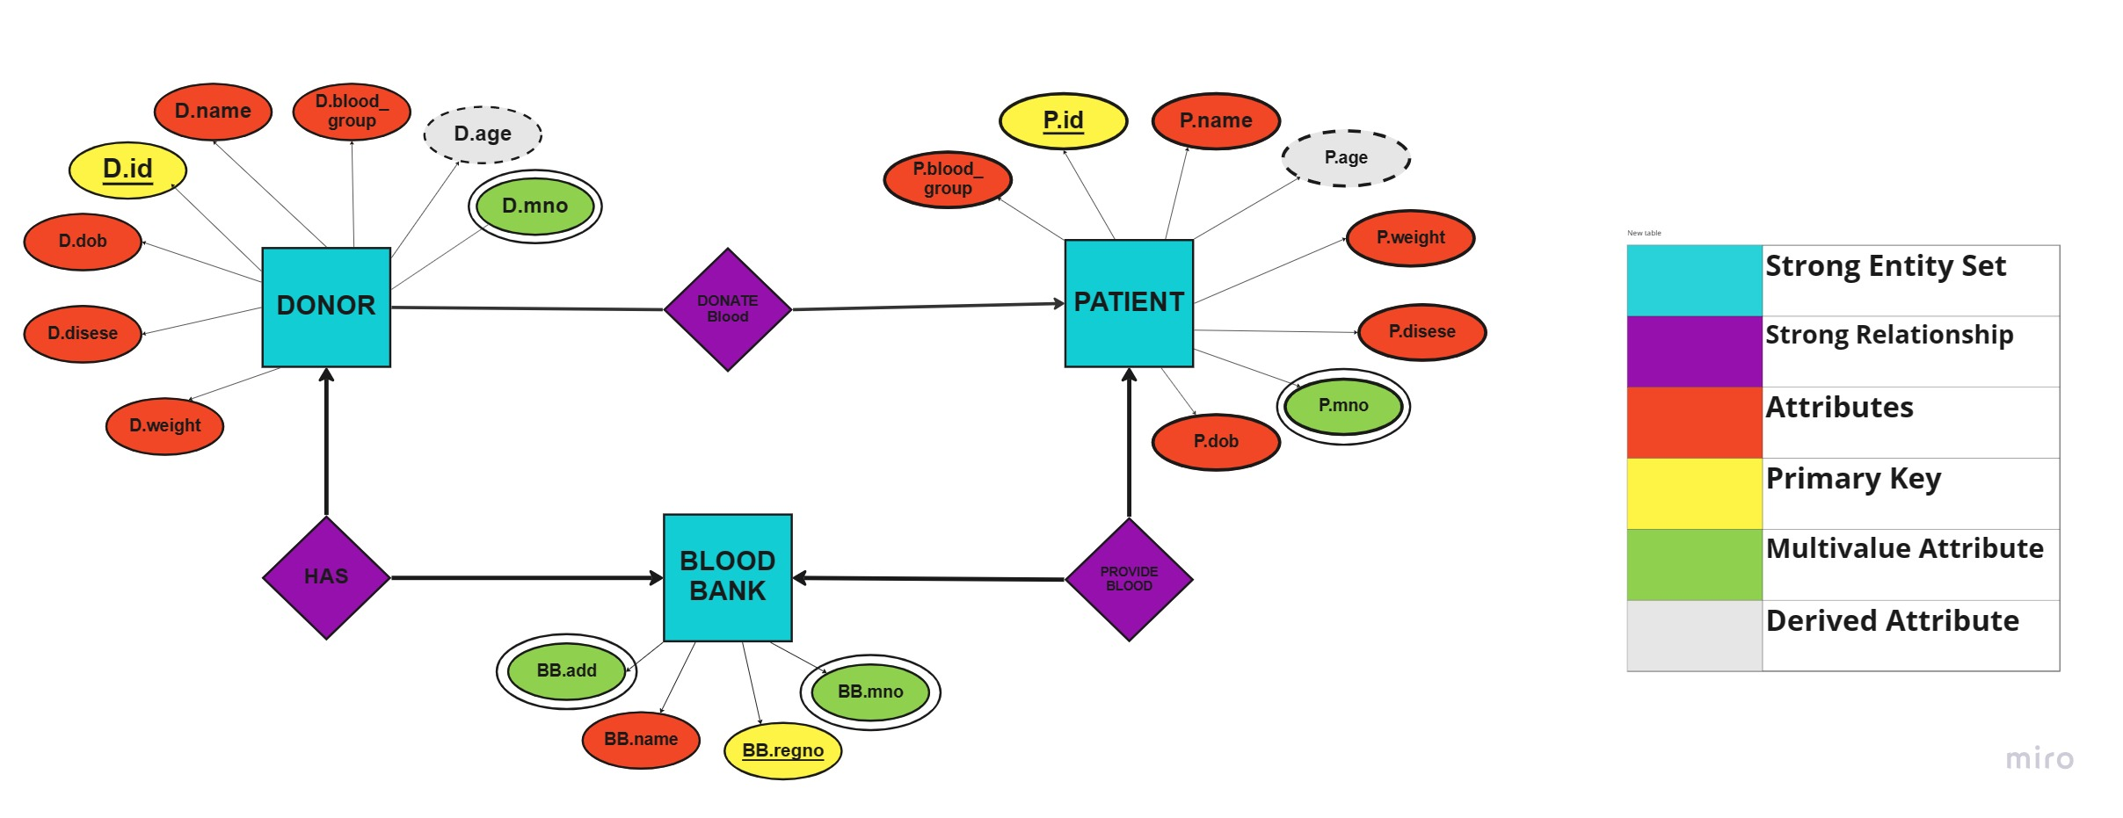
ENTITY-RELATIONSHIP DIAGRAM ( e-r DIAGRAM)

Slide 7
ENTITY SET TABLE
1) PATIENT
P.id | P.name | P.Blood_ group | P.Age | P.wieght | P.dob | P.disease
7770 | Roshan | A+ | 31 | 30 | 14-03-1990 | HIV
7771 | Salman | O+ | 27 | 40 | 14-07-1994 | Anemia
7772 | Ajay | AB+ | 44 | 44 | 18-08-1997 | Leukemia
7773 | Umesh | AB+ | 35 | 59 | 21-01-1985 | Sickel-cell
7774 | Sarita | B+ | 24 | 55 | 11-02-1997 | Liver
7775 | Tanvi | A- | 19 | 41 | 01-01-2002 | Cancer
7776 | Deepak | O+ | 29 | 34 | 05-11-1992 | Hemophilia
P.id | P.mno
7770 | 8564875621
7770 | 9585875624
7771 | 9264875622
7773 | 8864875625
7773 | 8964875623
7774 | 7764875624
7775 | 8664487623
7776 | 8294875629
7776 | 9562652620
7776 | 9052175626

Slide 8
2) DONOR
D.id | D.mno
369 | 8564875620
369 | 8064875621
895 | 9564875628
256 | 7774875623
987 | 8802487522
987 | 8560075621
168 | 8025654620
D.id | D.name | D.age | D.weight | D.blood-group | D.disease | D.dob
369 | Sudhir | 23 | 40 | O+ | None | 20-06-1999
895 | Ananya | 42 | 45 | AB+ | None | 01-06-1980
256 | Kabir | 34 | 35 | B+ | None | 12-12-1988
987 | Subadha | 32 | 38 | O+ | None | 06-05-1990
186 | Raunak | 43 | 50 | A- | None | 15-02-1980

Slide 9
3)BLOOD BANK
BB.regno | BB.name
474 | Ashirwad blood bank
514 | Holy family hosp blood bank
429 | G.T. hosp blood bank
298 | K.E.m. hosp blood bank
915 | J.J.hosp blood bank
BB.add
dadar
Bandra
parel
dhule
byculla
BB.regno | BB.mno
474 | 9564875624
514 | 9632417894
514 | 8963524176
429 | 7562146255
298 | 8126516264
915 | 9235452122

Slide 10
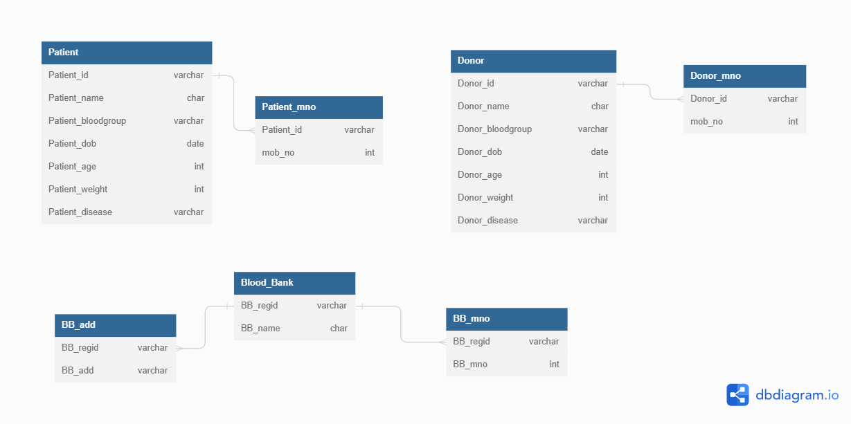
Relationship table

Slide 11
THANK YOU

